Slide 1

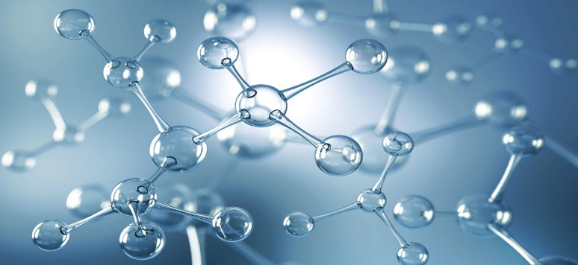
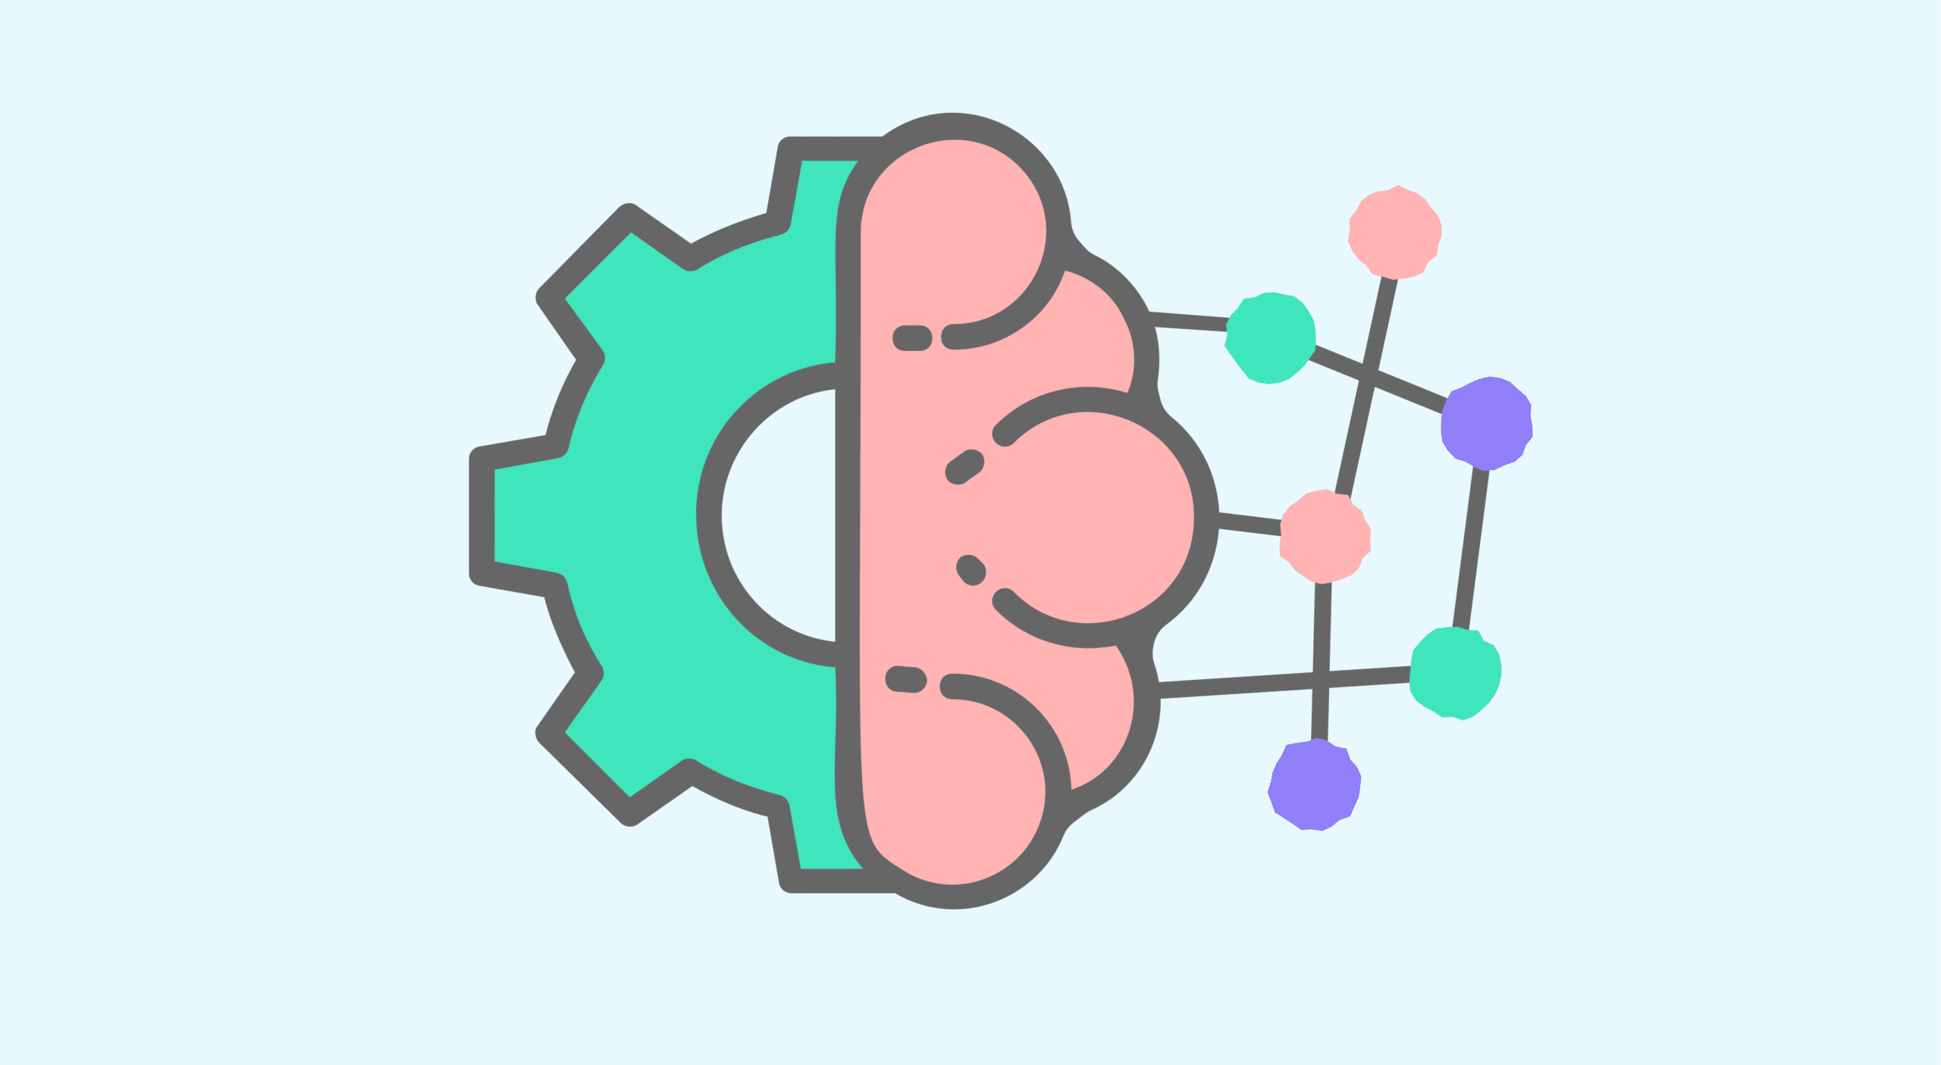
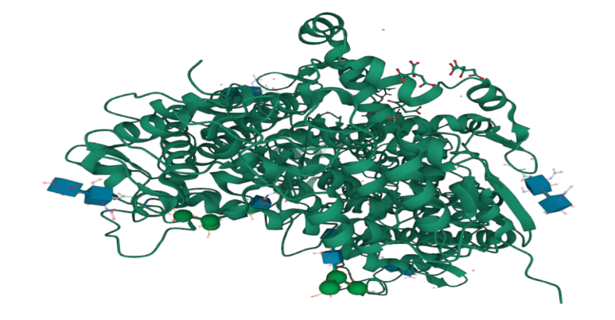
HUMAN CYCLOOXYGENASE-1 ACTIVITY PREDICTION
Input Molecule
Output=pIC50
Machine Learning
Predicted bioactivity
NAHID AKHTAR
Human COX-1 Enzyme

